Slide 1
Making Connections As A Trusted Advisor
Wilke & Associates
Certified Public Accountants
And
Small Business Advisors
David M. Wilke, CPA, MBA
Managing Partner
May 2016

Slide 2
Today We Will Apply Your Business Intelligence
To avoid the risks that accompany being a trusted advisor
To capitalize on the rewards that accompany being a trusted advisor
To qualify introductions
To discuss compliance and disclosure issues
And relate to “best practices” we promote at our firm

Slide 3
Risks VS Rewards
Risks of being a trusted advisor
Rewards of being a trusted advisor
How I developed my network and relationships
Example – Financial Advisors

Slide 4
Qualifying Introductions
Best practices to increase your value
  You know both parties
  You know they will be a fit for each other
  You back it
    Please meet or call the contact, if you don’t feel it is a good fit, let me know and I will introduce someone else
Avoid giving a list to your client to “interview”
A favorite connection story (2010 buyout introduction)

Slide 5
Compliance And Disclosure
Documentation and fee disclosure issues
Embarrassing introduction to a new financial advisor
A bad introduction, turned good
Biggest risk - likely new projects
Lowest risk - likely qualified professionals

Slide 6
What We Promote At Our Firm
Qualified introductions
Anticipate future problems for our clients and find reputable advisors
Historical performance metrics

Slide 7
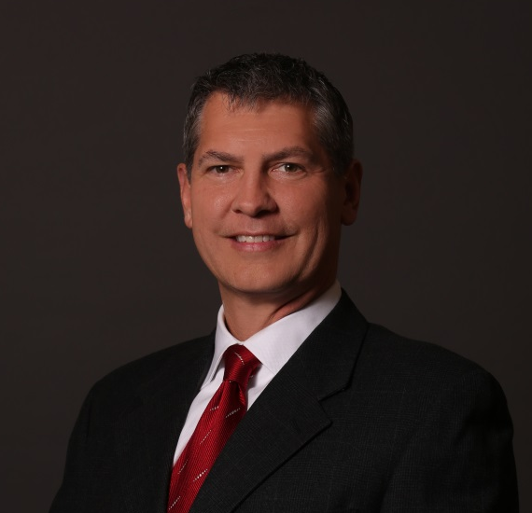
Thank You
David M. Wilke, CPA MBA
dwilke@wilkecpa.com
510 Washington Avenue
Carnegie, PA 15106
412-278-2200
412-278-1998
QUESTIONS?
COMMENTS?

